Slide 1

Deep Image Generation from Generative Adversarial Networks
HACK-A-ROO SPRING 2022
CS/Data Science/IT Track
Team: Beta Learners

Slide 2
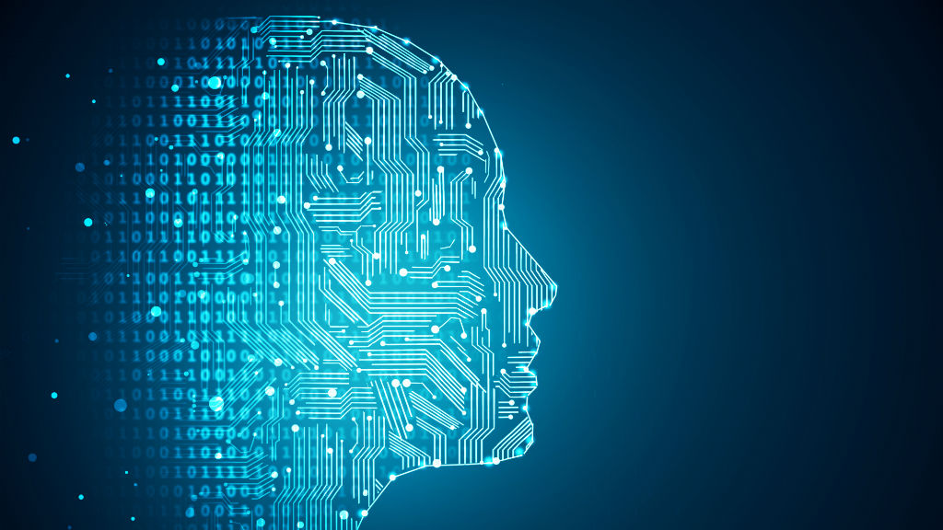
Problem Statement
To generate images from generative adversarial networks by training with a deep learning model with different types of datasets is challenging without the context of the images.
To develop a deep learning model to use available computer hardware to make the most realistic image possible within the specified time, funding, and skillset at commercial grade.

Slide 3
Image Generation using Generative Adversarial Networks(GANs)
Image generation is a set of techniques aimed at producing the most realistic image possible within the constraints of available computer hardware, time, funding, and skill set.
Not long ago, generative arts and NFT took the world by storm.
It is possible to generate more accurate images with AI-powered Generative Adversarial Networks.
Using GANs which is unsupervised learning, can generate images at scale.
It contains mainly two components:
Generator - Discriminator

Slide 4
Hack - Solution
The main idea is to develop deep learning models to take the specific dataset related to images and generate similar images. Two models are designed to handle the solution:
Realistic than the original images without context.
Taking input from the user like type and context related to the image and generating the images
Both are different models as they need separate training and development.
The images generated by the system can be used by various users like:
Designers
UI/UX Designer
Artists
NFT Developers
Advertisement Agencies

Slide 5
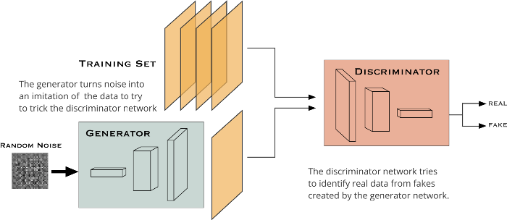
Model 1: Deep Fake Face Image Generations
As part of the first task generating images from a natural context is a domain-specific task. As each image is associated with a different context.
To develop Deep Fake Face Image Generation, the system is trained to generate images based on the training from celebrities’ image data set.
A custom build GAN is used to do the task. How does the model operate?

Slide 6
Image GANs for Faces
In a nutshell, we will ask the generator to generate faces without giving it any additional data.
Simultaneously, we will fetch the existing faces in the dataset to the discriminator and ask it to decide whether the images generated by the Generator are genuine or not.
At first, the Generator will generate lousy images that will immediately be labeled as fake by the Discriminator.
After getting enough feedback from the Discriminator, the Generator will learn to trick the Discriminator as a result of the decreased variation from the genuine images.
Consequently, we will obtain a very good generative model which can give us very realistic outputs.

Slide 7
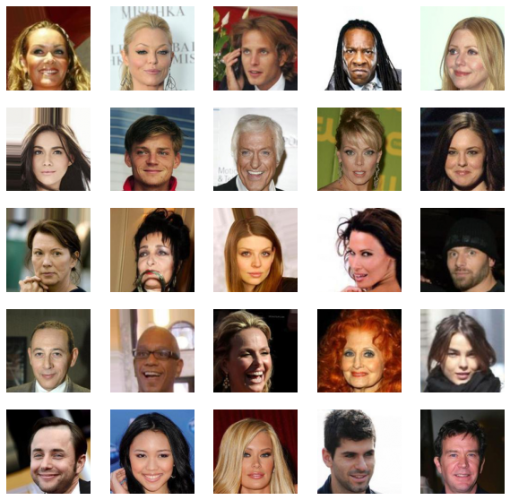
Sample Images from CelebA Dataset

Slide 8
Generated Images from Model 1

Slide 9
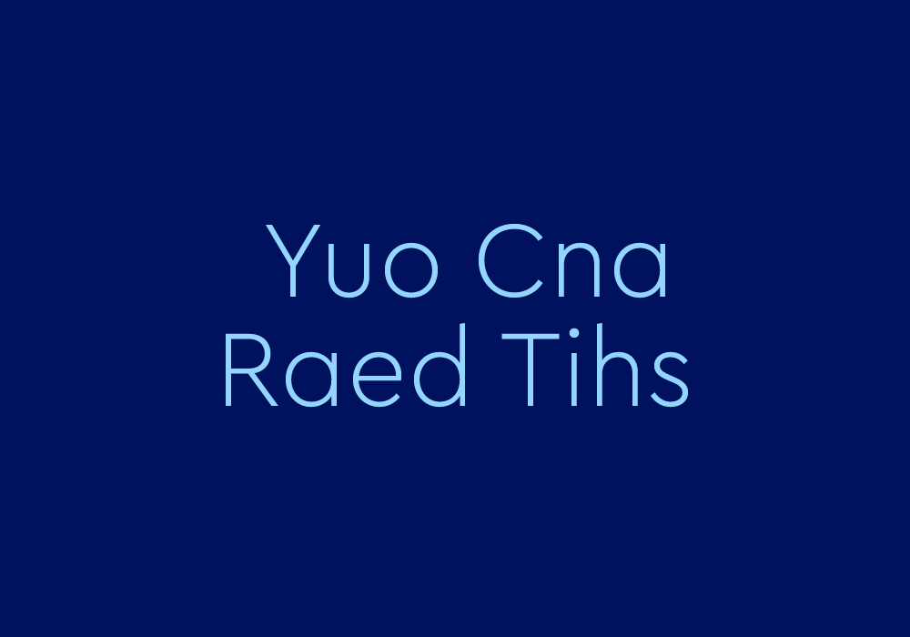

Slide 10
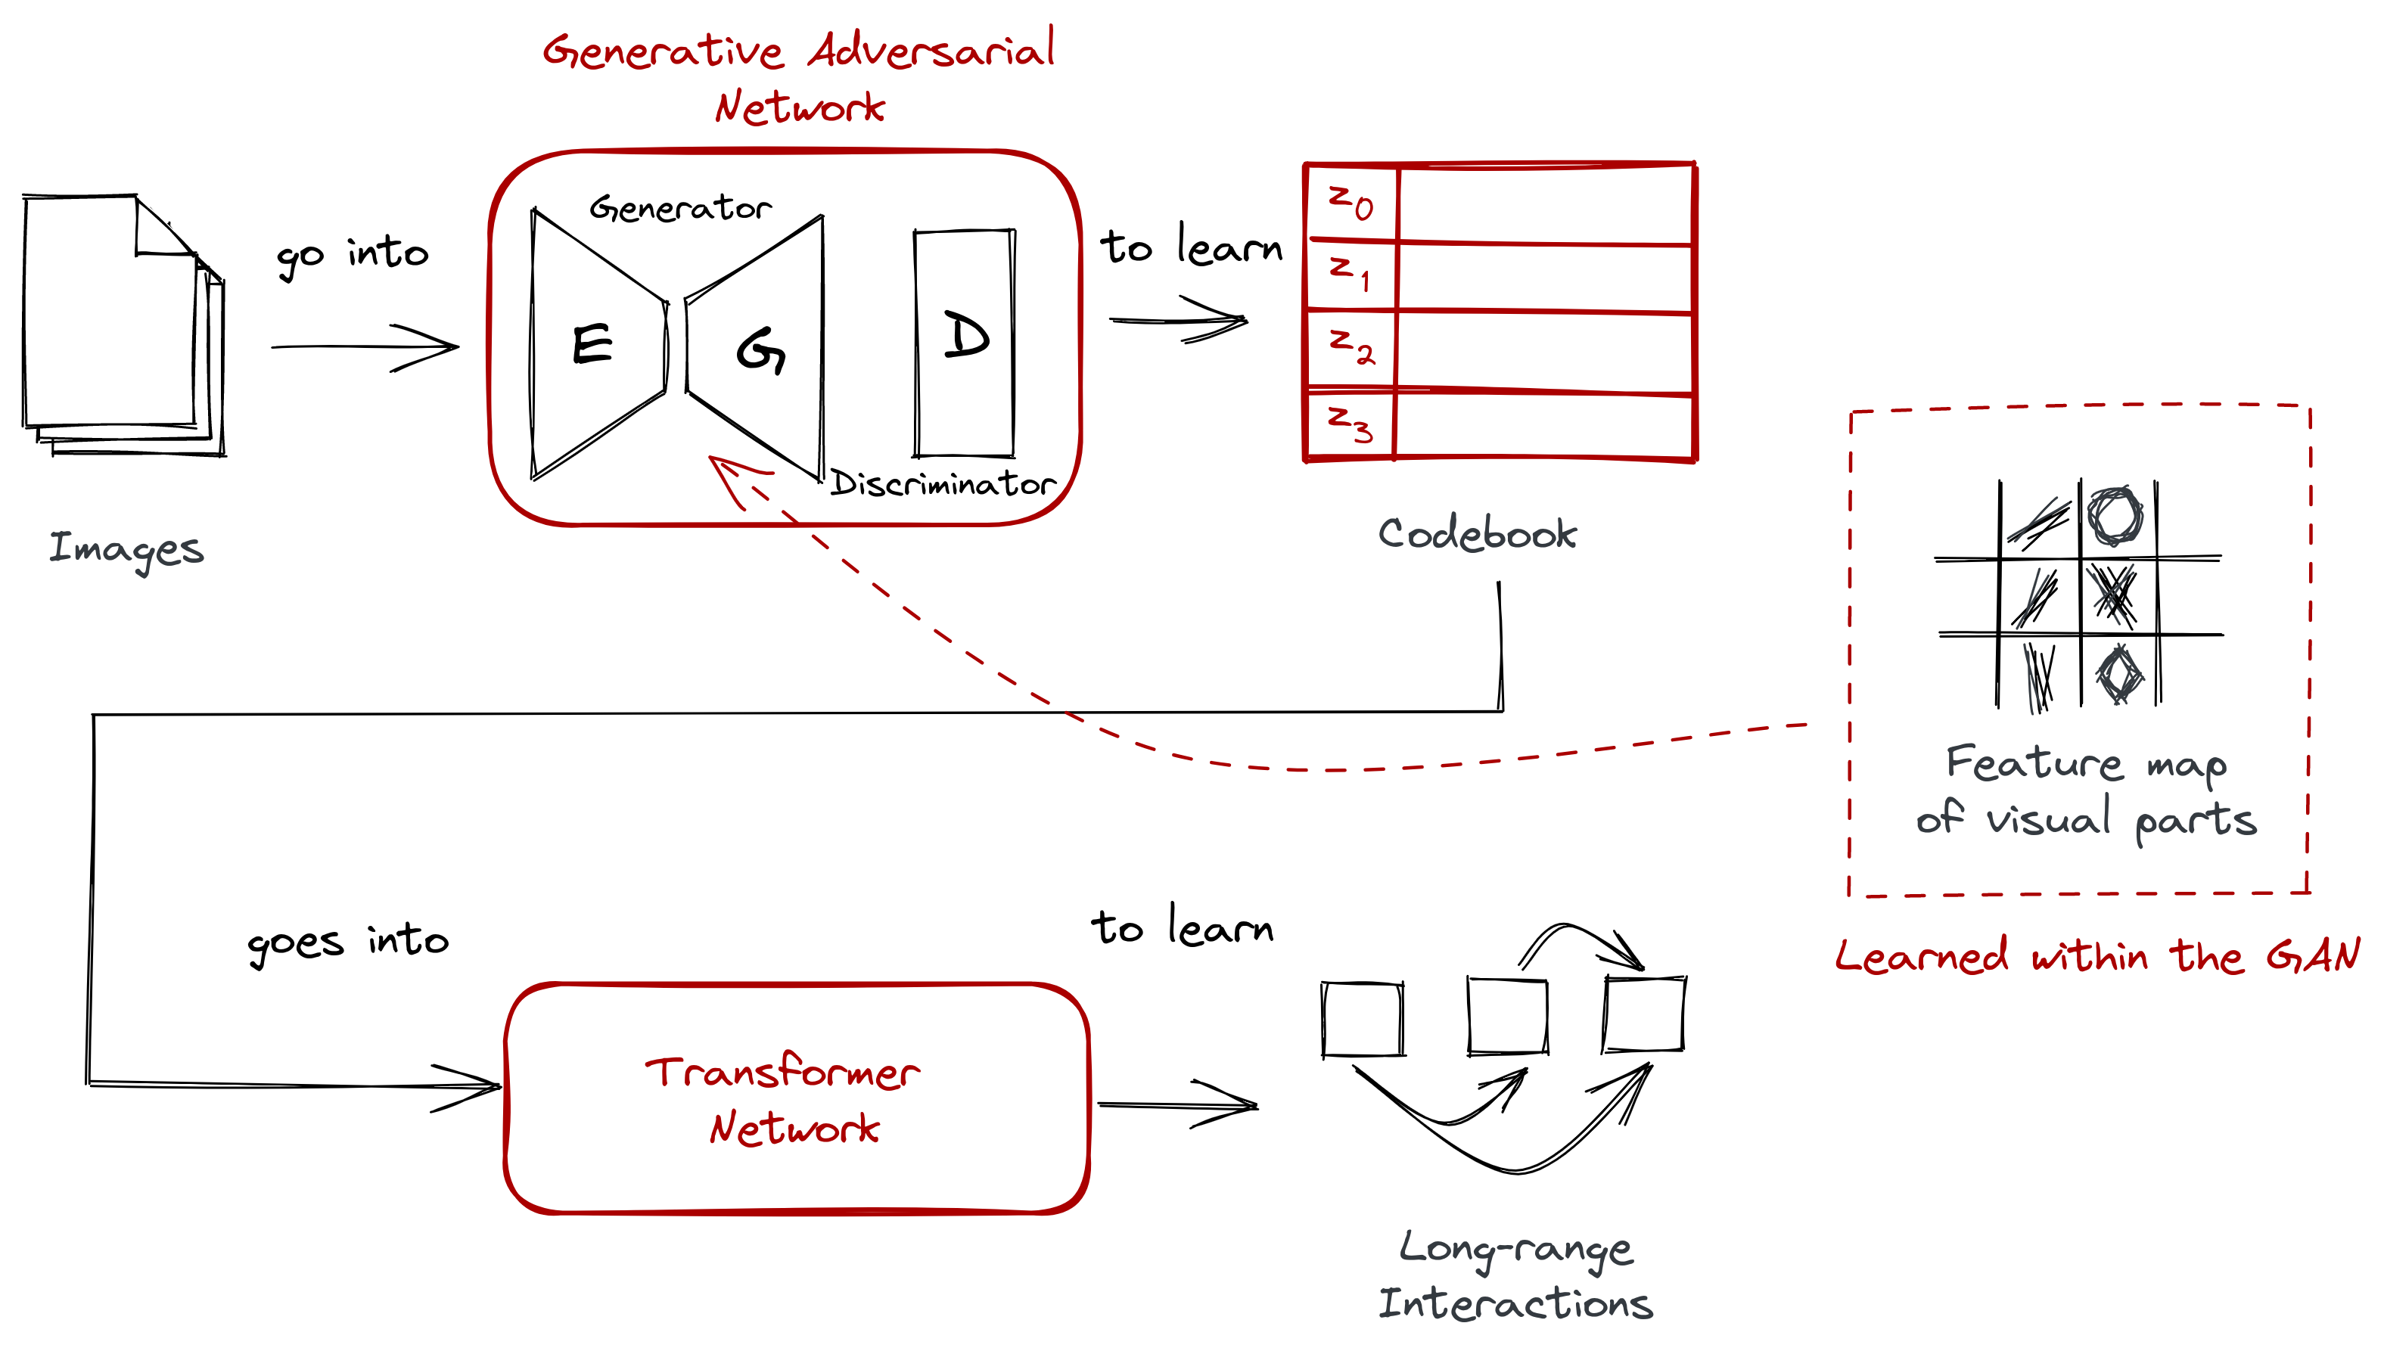
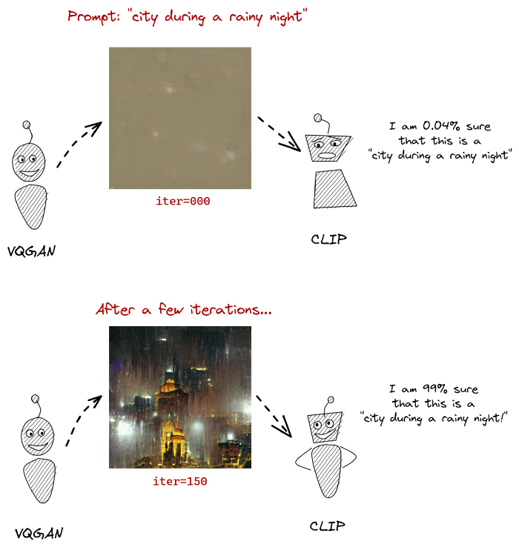
Model 2: Context-based Image Generation from VQ-GAN and CLIP.
VQ - GAN is a generative adversarial neural network that is good at generating images that look like others (but not from a prompt)
CLIP is another neural network that can determine how well a caption (or prompt) matches an image.
Images Source: https://ljvmiranda921.github.io/notebook/2021/08/08/clip-vqgan/

Slide 11
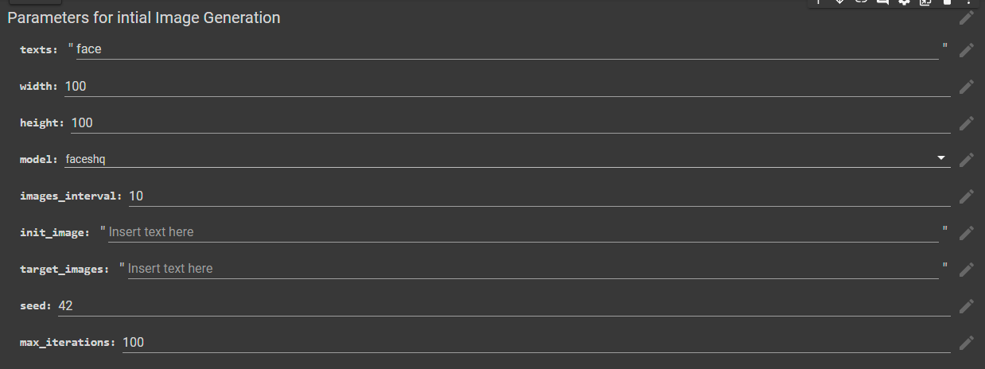
Generated Images from Model 2
Input:

Slide 12
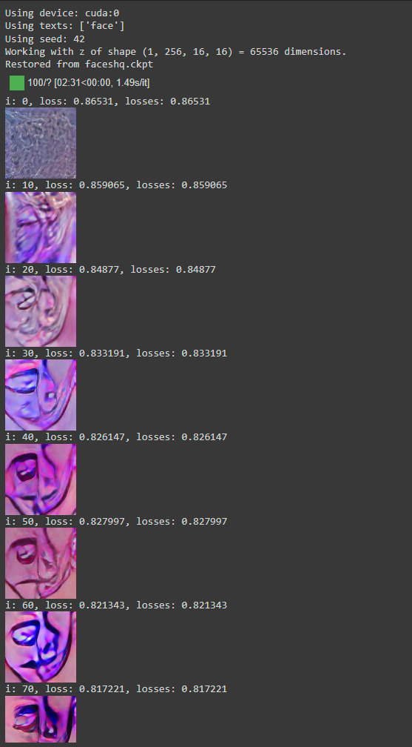

Output After only 100 Iterations….
Iterative Video Representation

Slide 13
Implementation
Dataset:
CelebA Dataset
ImageNet
COCO (Common Objects in Context)
FacesHQ (Flicker Faces HQ Dataset)
Wiki Art
Flicker30K: Standard Benchmark for Sentence Based Image Description
Environment:
Google Colab (Google Collaborative Research Environment for Deep Learning)
Framework:
PyTorch: Open-source machine learning framework based on the Torch library, used for applications such as computer vision and natural language processing, primarily developed by Facebook's AI Research lab.
Language:
Python
Github Link: https://github.com/vnreddy60/Image-Generation-GANs

Slide 14
Conclusion
Both Models showed the art type image generation with realistic features.
Due to limited computation usage of GPU, the models are trained for a limited time.
The models can be further improved by increasing the training time. This is an iterative process. Which is a scheduled task running in the background based on the loss percentage of the model generation.
Model will be deployed with FastAPI and enable the user interface at a later stage of the implementation for commercial grade usage.

Slide 15
Thank you
Team: Beat Learners
Vinay Reddy Kalluri
Muni Kanaka Sri Shalini Chintam
Karthik Yanagandula
Gayathri Garikapati

